Slide 1
Mutinomial Naive Bayes Classifier
Multinomial Naive Bayes is one of the variation of Naive Bayes algorithm which is ideal for discrete data and is typically used in text classification problems.
It models the frequency of words as counts and assumes each feature or word is multinomially distributed.
It is widely used for tasks like classifying documents based on word frequencies like in spam email detection.
Efficient for high-dimensional datasets with thousands of features.

Slide 2
"Multinomial" refers to how many times a word appears or how often a category occurs.
It works by using word counts to classify text.
The main idea is that it assumes each word in a message or feature is independent of each others.

Slide 3
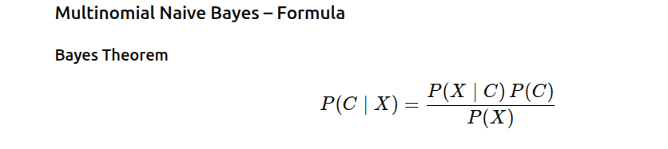
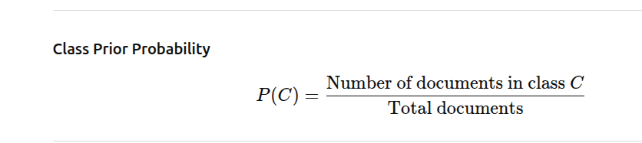
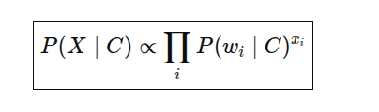
X is the document

Slide 4
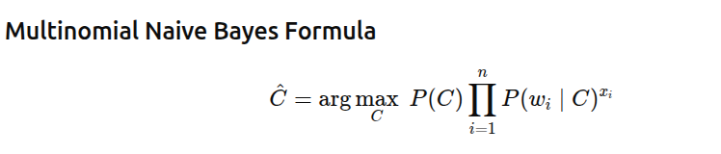
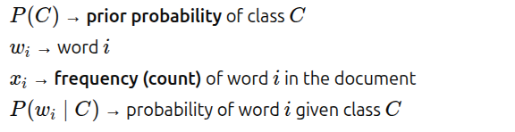
Calculate the probabilities of each word given in the Class. Maximum Likelihood Estimation helps finding probabilities based on actual counts from the data.

Slide 5
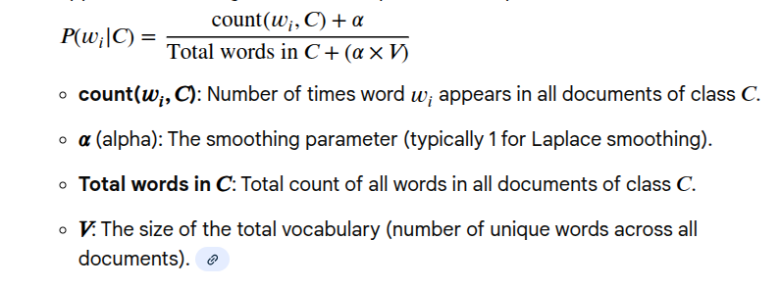
Likelihood (with Laplace smoothing), P(X|C)

Slide 6

Choose the class with max probability

Slide 7
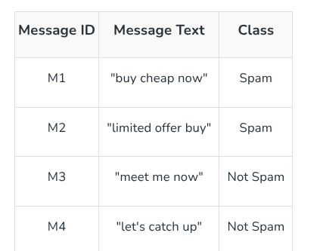
Example -Dataset

Slide 8
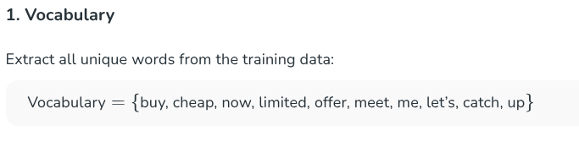
Test message(document): “buy now”

Slide 9
Priors
P(Spam)=2/4=1/2
P(Not Spam)=2/4=1/2

Slide 10
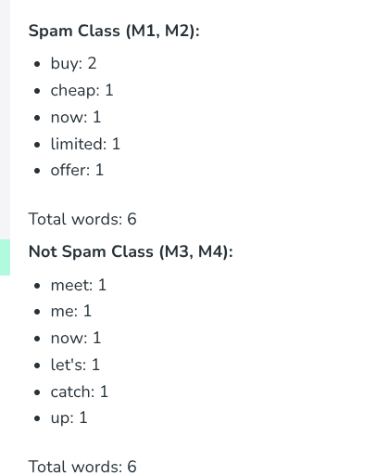
Word Frequencies based on class

Slide 11
Likelihood
Class =Spam
[ P(buy|Spam) = (2+1)/(6+10) = 3/16 ]
[ P(now|Spam) = (1+1)/(6+10) = 2/16 ]
Class=Not Spam
[ P(buy|Not Spam) = (0+1)/(6+10) = 1/16 ][ P(now|Not Spam) = (1+1)/(6+10) = 2/16 ]

Slide 12
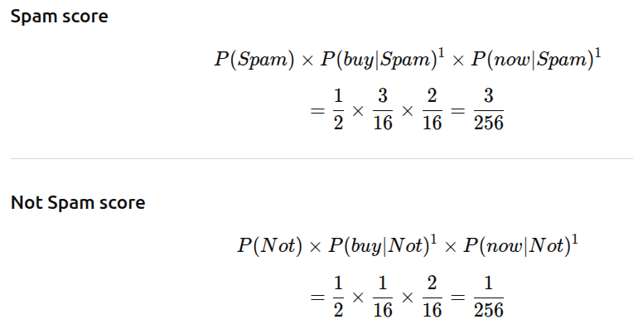

Slide 13
Final Classification
P(Spam∣X)=3/256=0.0117
P(Not Spam∣X)=1/256=0.0039
Since P(Spam∣X)>P(Not Spam∣X),
The message is classified as: Spam

Slide 14
Advantages
Fast training and prediction
Works well for text classification
Uses word frequency
Performs well with large vocabularies

Slide 15
Disadvantages
Assumes features are independent
Not suitable for binary-only data
Does not handle continuous features
Ignores word order and meaning

